Slide 1





STOCK MARKET FORECAST
Team : CHANTHRU B
Email : Chanchanthru027@gmail.com
Guide: (P.Raja, Master Trainer )
Disclaimer: The content is curated for educational purposes only.
Notes:
Slides: Prepare a short slide deck (10-12 slides) summarizing the project objectives, methodology, and key results.

Slide 2
OUTLINE
Abstract
Problem Statement
Proposed System/Solution
Algorithm & Deployment
GitHub Link
Project Demo(photos / videos)
Conclusion
Future Scope
References

Slide 3
Abstract
This project explores the use of artificial intelligence (AI) to autonomously generate music. The goal is to create an AI system that can compose music across different genres by leveraging machine learning models, including Recurrent Neural Networks (RNNs) and Generative Adversarial Networks (GANs). The system allows users to customize input parameters such as genre, mood, and instrumentation.

Slide 4
Problem Statement
With the increasing accessibility of artificial intelligence (AI), music generation has become an exciting area of exploration. Traditional music composition requires considerable time, skill, and creativity, but AI-driven approaches promise to automate the process. However, generating music that maintains both technical quality and emotional depth remains a challenge for AI systems.

Slide 5
Proposed Solution
To solve this project focuses on developing an AI-driven system for automatic music generation across multiple genres (e.g., classical, pop, jazz). It will allow users to customize music based on parameters like mood, tempo, and style. The system will leverage machine learning algorithms to produce original, high-quality compositions with a focus on musical coherence and emotional impact. The project will support both real-time and batch music generation, with applications in areas such as game soundtracks, film scoring, and content creation.

Slide 6
Github project link
https://github.com/Chanthrubalamurugan/NAAN-MUDHALVAN-PROJECT.git
Notes:
thank you very much for joining this PPT, keep learning.
6

Slide 7
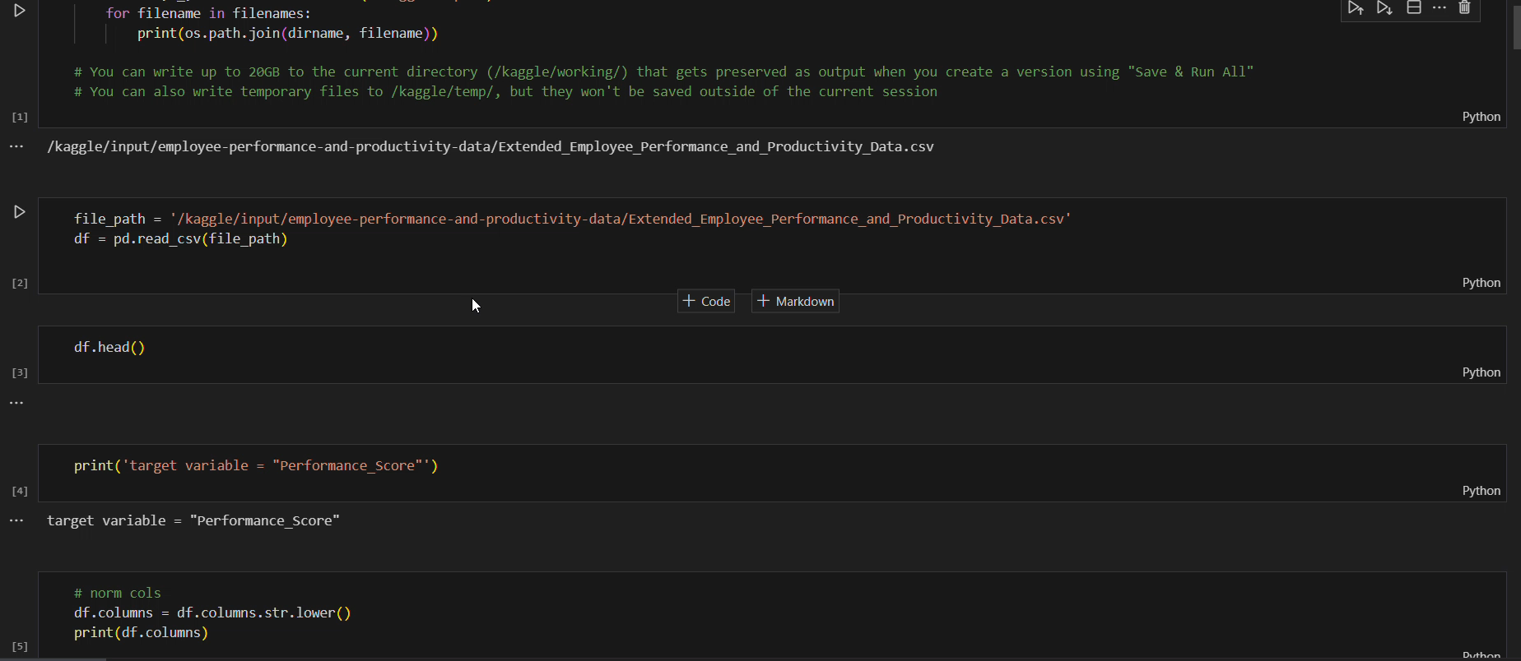
Video of Project Demo

Slide 8
Conclusion
This project successfully combines face recognition and emotion analysis with personalized music generation, providing a dynamic and adaptive user experience. Future improvements will enhance accuracy and performance, broadening its applications in various domains

Slide 9
Future Scope
Real-time
AI-driven
cross-industry
personalized
predictive.

Slide 10
Thank you!
Notes:
thank you very much for joining this PPT, keep learning.
10

